Slide 1
Computer Principles for Programmers
Overview of Number Systems, Software Versioning, and Software Version Control Systems

Slide 2
Quiz

Slide 3
News of the Week

Slide 4
Agenda
Lecture:
Analog vs Digital, Number Systems
Why do computers need binary?
Why do we care?
How can we use it?

Slide 5
Agenda (Cont’d)
Lecture:
Why “Hexadecimal” numbers?
“Software Versioning”, “Software Release Numbering”, and how you can use it.
“Software Version Control Systems”: their usage and importance.

Slide 6
Agenda (Cont’d)
Activities:
Identify and solve an integer overflow bug.
Boolean logic: should you come to school today?
Work with colours in both Decimal and Hex RGB values.
Identifying typical software versions.

Slide 7
Analog vs Digital
Humans
Computers
Analog
Decimal
Digital
Binary
See this URL for more on Analog vs Digital:
https://chortle.ccsu.edu/java5/Notes/chap02/ch02_1.html
Notes:
Real Life is analog and we count in tens. Digital Life is on or off, in bits and bytes and ones and zeros. In both cases, we hope that our checksums are not in a negative balance and that we remain in parity.
People: how are you? Fine or Lousy. That is usually a binary answer heard as analog. Your friend knows if you are really 80% fine and 20% lousy. Or, your friend understands irony: when you say “lousy” at a great party and “just fine” near the end of exam week are both understood with the logical NOT.
Computers: The CPU says to the memory cache, “How are you?” Memory cache says, “I think I have a parity error.” CPU says, “Yeah, you look a bit off.”
People: how is your computer? No one knows for sure. From the computer’s POV, what does it know about how it is? Only that it is ON or OFF. There is no MAYBE. That’s OK, who wants a computer that can’t make up its mind.
This link is and excellent illustration of analog vs binary: https://chortle.ccsu.edu/java5/Notes/chap02/ch02_1.html

Slide 8

Numbering Systems
Humans tend to think in base 10: decimal.
Notes:
Number systems:
Each digit is one for a total of ten on both hands.

Slide 9
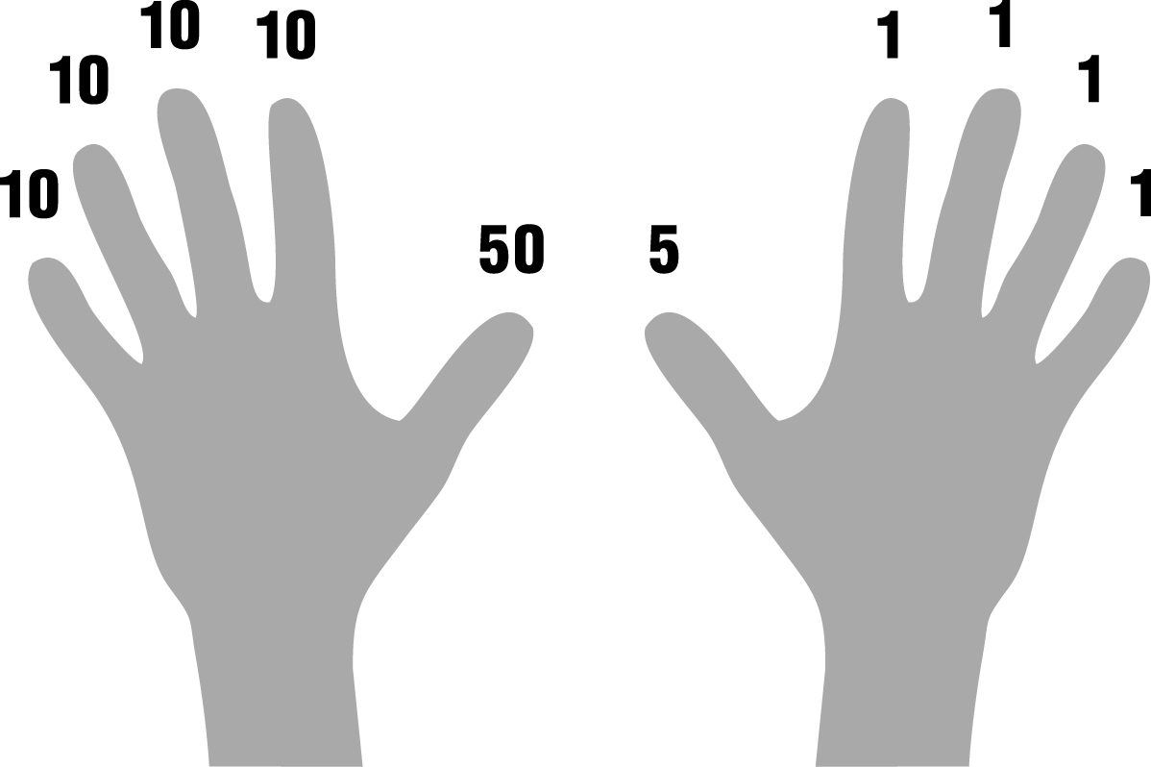
Numbering Systems
But we can think differently.
Notes:
Number systems: count to 99 on ten digits.
This finger counting system may have been the origin of the Roman symbols: right hand fingers are ones and the thumb is five, left hand fingers are tens and the thumb is fifty. This is a very useful method of counting and keeping track of numbers up to 99 in a noisy and busy environment. Fingers on the right hand go up, index to pinky for 1,2,3,4; then the fingers go down for 5 and the thumb comes up. Thumb + index to pinky for 6, 7, 8, 9. For 10, the right hand closes and the left hand’s index finger goes up.

Slide 10
Numbering Systems
How many ways can you represent 2,017?
1,1,1,1,1,1,1,1,1,1,1,1,1,1,1,1,1,1,1,1,1,1,1,1,1,1,1,1,1,1,…
One, two, three, many.
MMXVII
0-9 and columnar position to indicate orders of magnitude: ones, tens, hundreds, thousands
11111100001
8:17pm
Numbers, by themselves, are just…numbers. Context matters.
The cardinal number 2,017 is different from the year 2017.
Bigness / Littleness depends on context: years, $$$, stars.
Notes:
We often think differently about numbering systems.
e.g. 2,017
1,1,1,1,1,1,1,1,1,1,1,1,1,1,1,…this is going to go on for quite a while and will be a big pile of ones.
One, two, three, many. That’s it. Four values are all some societies have needed. Would that modern life would be so simple.
Romans used units of ones, fives, tens, fifties, hundreds, five-hundreds, thousands: MMXVII
Arabic numerals used a unique symbol for each of 0-9 and columnar position to indicate orders of magnitude X 10: ones, tens, hundreds, Thousands, etc.
In binary, 2017 is 11111100001 (not very useful, is it?)) See https://instacalc.com/1439
Context matters
2,017 as a cardinal number is very different from 2017 as a Gregorian year.
20:17:00 is 8:17pm where the base for seconds and minutes is 60 but for hours it is 24.
Our brains have concepts of orders of magnitude depending on context
Thousands is a lot in terms of years, not as much as it used to be in terms of dollars, not very many in terms of stars in the universe.

Slide 11
Common orders of magnitude
Decimal Value | Symbol | SI prefix | Binary Value | Greek origin
1000 | k (or K) | kilo | 2¹⁰ = 1024 | chilioi “thousand”
1000² | M | mega | 2²⁰ = 1024² | megas “great”
1000³ | G | giga | 2³⁰ = 1024³ | gígas "giant"
1000⁴ | T | tera | 2⁴⁰ = 1024⁴ | teras "monster"
1000⁵ | P | peta | 2⁵⁰ = 1024⁵ | pénte “five”
1000⁶ | E | exa | 2⁶⁰ = 1024⁶ | héks “six”
1TB decimal = .90949TB binary. 1TB binary = 1.0995TB decimal
Notes:
The decimal and binary values are frequently confused with the decimal version becoming more commonly used.
The Greek origins of terms were very interesting for a while.

Slide 12
Binary Numbers
Zeros and Ones, On / Off, True / False
Bit = Binary digIT Values { 0 – 1 } (J.Tukey, 1946. C.Shannon, 1948. Bell Labs)
Byte = 8 bits (W. Buchholz, 1956. IBM) Values { 0 – 255 }
2⁷ | 2⁶ | 2⁵ | 2⁴ | 2³ | 2² | 2¹ | 2⁰
128 | 64 | 32 | 16 | 8 | 4 | 2 | 1
0 | 1 | 0 | 1 | 0 | 1 | 0 | 1
Decimal value
‘U’ or 85 =
Notes:
BYTE was expansion of bit, coined by Dr. Werner Buchholz in July 1956, during the early design phase for the IBM Stretch computer. Byte was a deliberate respelling of bite to avoid accidental mutation to bit.
Bemer, RW; Buchholz, Werner (1962), "4, Natural Data Units", in Buchholz, Werner, Planning a Computer System – Project Stretch(PDF), pp. 39–40
Byte: A sequence of adjacent bits (binary digits) that can be operated on as a unit by a computer; the smallest usable machine word; nearly always eight bits, which can represent an integer from 0 to 255 or a single character of text.
The C and C++ programming languages define byte as an "addressable unit of data storage large enough to hold any member of the basic character set of the execution environment" (clause 3.6 of the C standard). The C standard requires that the integral data type unsigned char must hold at least 256 different values, and is represented by at least eight bits (clause 5.2.4.2.1).
Binary Number Game
http://www.wordfreegames.com/game/binary-game.html (easier)
https://studio.code.org/projects/applab/iukLbcDnzqgoxuu810unLw (challenging)

Slide 13
Why Binary?
Unequivocal state:
1 or 0 for storage of a value in one or more bits
Electric current in RAM, magnetic charge on HDD, magic in SSD
TRUE or FALSE to make a decision (Boolean logic)
hardware uses logic gates,
software uses Selection logic, e.g. IF statements resolve to TRUE or FALSE.
Faster Processing:
CPUs, ALUs, xxUs are faster in binary
Notes:
http://nookkin.com/articles/computer-science/why-computers-use-binary.ndoc
Why do all modern-day computers use binary then?
Simple answer: Computers weren't initially designed to use binary [early ALUs were decimal]... rather, binary was determined to be the most practical system to use with the transistor/solid-state/semi-conductor computers that followed the invention of the microchip.
Full answer: We only use binary because we currently do not have the technology to create "switches" that can reliably hold more than two possible states. (Quantum computers aren't exactly handy at the moment.) The binary system was chosen only because it is quite easy to distinguish the presence of an electric current from an absence of electric current, especially when working with trillions of such connections. And using any other number base in this system ridiculous, because the system would need to constantly convert between them. That's all there is to it.

Slide 14
Bits, Bytes, and Precision
n bits can encode 2^{n} numbers
8-bit char = 2⁸ = 256 values (unsigned 0 – 255)
16-bit short = 2¹⁶ = 65,536 values
Signed: −32,768 to 32,767
32-bit long = 2³² = 4,294,967,296 values
Signed: −2,147,483,648 to 2,147,483,647
int type may be short or long depending on platform, language, etc.
Notes:
Binary is easy for computers and hard for humans.
Integers come only in multiples of the 8-bit byte “word” or register size, the smallest unit of data in computer architecture.
How many bits do you need to store 2017 in binary? 13. Who would know this off the top of their head?
PROBLEM: int type may be short or long depending on platform, language, etc.
Recommend you say what you mean: short or long or 16-bit or 32-bit but not “int”.
A long long or big integer (IBM’s BIGINT) is a 64-bit binary integer with a range of -9,223,372,036,854,775,808 to +9223372036854775807. That’s a 9 with 18 zeros or 9 quintillion.
CPUs address similar amounts of RAM depending on their addressing bit width:
32 bit processors or operating systems can address a maximum of 4GB RAM
32 bit application software can address only 2GB of memory for variables and it’s own data (the rest of RAM is for the OS and the program itself) regardless of whether it runs on a 32-bit or 64-bit OS.
64 bit application software can address far more memory but must be compiled, tested, and run on a 64-bit platform.
https://msdn.microsoft.com/en-us/library/0b726ydb.aspx
http://en.cppreference.com/w/c/types/integer
https://en.wikipedia.org/wiki/C_data_types

Slide 15
Two's Complement
Positive and Negative numbers each share half the bits of an integer.
The high order bit becomes the sign bit.
A negative value is the mirror image of its positive’s bits + 1.
+2 0000 0010 1111 1101 +1 −2 1111 1110
Notes:
Reference https://www3.ntu.edu.sg/home/ehchua/programming/java/datarepresentation.html
This example shows a type __int8, a signed version of the char type which is rarely used but useful for the example. Short, long, and long long integers use the same scheme.
https://en.wikipedia.org/wiki/Two's_complement
The two's-complement system has the advantage that the fundamental arithmetic operations of addition, subtraction, and multiplication are identical to those for unsigned binary numbers. This property makes the system both simpler to implement—there is no special handling of positive vs negative numbers—and is capable of easily handling higher precision arithmetic.
The disadvantage is overflow when +127 + 1 becomes −128.
But we have that problem with decimal numbers, too.
In IBM databases, there is a DECIMAL data type, base 10, just like humans use. It has always been used for business and financial applications.
E.g. 9.2 is 1,234,567.89 It overflows at ten million dollars. Even with decimal data types, we have to ask, “Is this big enough?”

Slide 16
Binary Processing Cautions
How many bits are enough?
Any numeric type can overflow
signed integer overflow is undefined behavior in C99
signed overflow behaves like unsigned on most systems, integers wrap around: −32,768 ← 0 → 32,767 but + 1 = −32,768
Do not do any ‘clever’ programming using this.
BE VERY CAREFUL MIXING SIGNED AND UNSIGNED
C# and Java do not have unsigned integer types
Notes:
As programmers we need to conceptualize binary orders of magnitude.
What integer length is needed to hold 2017? Is 8 bits enough? 16? Is 32 or 64 too much of a memory hog?
What is the maximum value for a signed int32? Remember from the previous slide? 2,147,483,647
If you think the value is too hard to remember in base 10, it’s easy in base 2, it’s 31 ones: 1111111111111111111111111111111
Easiest way to remember exactly is to get a tattoo.
Or just remember +/- 2 billion.
In the C programming language specification, signed integer overflow causes undefined behavior because there are three different architectures to store signed values, all with different side effects. On most platforms—because most use Twos Complement—signed overflow behaves like unsigned integer overflow: integers wrap around on overflow. 32,767 + 1 = −32,768 − 1 = 32,767
Unsigned Integers can hold twice as many positive values as signed but twice as much is rarely enough and the side-effect danger of mixing unsigned and signed integers is not worth it.
C# and Java don’t provide unsigned integer types for good reason: it’s too prone to subtle errors introduced by binary processing when signed and unsigned are mixed in calculations.

Slide 17
Binary Processing Cautions
How many bits are enough?
Gangnam Style overflows INT_MAX, YouTube goes 64-bit
If a counter tracks the number of hundredths of a second of a machine’s cumulative operation, how many days would it take for a signed integer to overflow?
For a short? (32,767) For a long? (2,147,483,647)
 + R, “calc”
The end of 32-bit time: January 19, 2038 03:14:07
Notes:
Integer overflow
https://www.youtube.com/watch?v=9bZkp7q19f0 at 2,757,501,680+ views as of 2017 Winter term.
On 30 April 2015, the Federal Aviation Authority ordered Boeing 787 Dreamliner operators to reset its electrical system to avoid an integer overflow which could lead to complete loss of normal electrical power and ram air turbine deployment to generate emergency power. Boeing issued a software update in the fourth quarter of 2015 before the overflow would happen again. The error happened after 2³¹ centiseconds (248.55134814815 days) of operation indicating a 32-bit signed integer. (2,147,483,647 / 100 hundredths / 60 seconds / 60 minutes / 24 hours) Even if they had counted full seconds, it would not have happened for 24855 days or 68 years. That’s still a bit tight; Douglas DC-3’s have been flying for 70+ years. So an unsigned 32-bit int counting only full seconds would have been enough but because subtle errors can occur when mixing signed and unsigned integers, that might not have been a solution. If the programmer specified a “long long” int; it would have taken 3 billion years to overflow counting hundredths of a second.
Big (long int) and little things (hundredths of a second) are hard to gauge.
https://en.wikipedia.org/wiki/Integer_overflow
Unix systems record time values as the number of seconds, positive or negative, since 00:00:00 UTC on January 1, 1970. 32-bit systems use a signed 32-bit integer for this which gives a range of 1970 +/- 68 years.
But 2,147,483,647 seconds after that date, the integer value will wrap around. On January 19, 2038, at 03:14:07 in the morning, 32-bit Unix systems will go back in time 136 years.
Not a problem for any contemporary UNIX system, they are all 64-bit. But what about small 32-bit embedded systems?
Activity:
What is wrong with this line of code? mid = (low + high) / 2; // low and high and mid are all integers of the same size.

Slide 18
Boolean Logic: TRUE or FALSE
GOTO school
IF DoW = Monday AND classesMon > 0 AND NOT sick
IF TRUE AND classesMon > 0 AND NOT sick
IF TRUE AND TRUE AND NOT sick
IF TRUE AND NOT FALSE
IF TRUE AND TRUE
IF TRUE THEN goto school
If it’s not Monday OR no classes OR you are sick, don’t go.
Notes:
Boolean Algebra and logic gates
If the Day of Week is Monday, then continue evaluating the expressions
If you have one or more classes on Monday, then continue evaluating the expressions
TRUE + TRUE = TRUE, continue evaluating the expressions
Are you sick? You’re here so lets assume you are not sick, i.e. the variable “sick” = FALSE
NOT FALSE is TRUE
TRUE + TRUE = TRUE, so goto school
The same logic can be expressed negatively with ORs instead of ANDs.
All Boolean expressions resolve to a simple TRUE or FALSE.
All logic expressions joined by AND must be true for the whole expression to resolve to TRUE. One FALSE negates any number of AND TRUEs.
OR starts a new condition. OR connects two conditions and returns true if either condition is true or if both conditions are true.

Slide 19
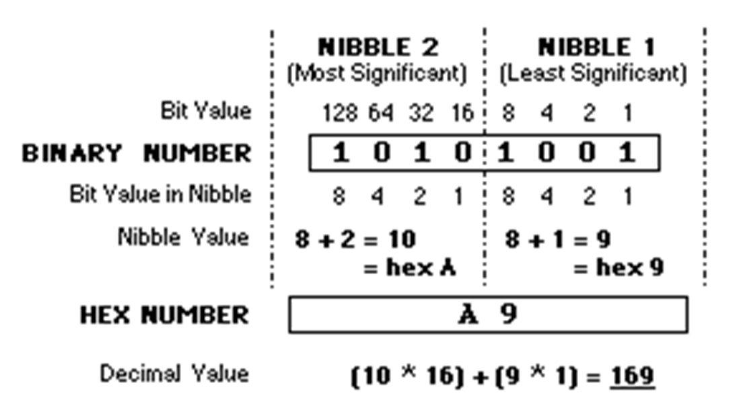
Hexadecimal
Hex is base 16
Why?
easier than binary
8 bit byte = 256 = 16 * 16
0–15: One – Nine, Able, Baker, Charlie, Dog, Easy, Fox
Notes:
How to “convert from Decimal to Binary to Hex”? Use Google.
256 is also 16^2, thus HEX.
Concept of nibbles, easier to count 0 to F twice than 0 to 255 all the time.

Slide 20
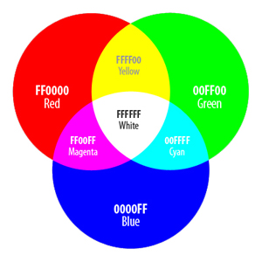
Hexadecimal color codes are used in HTML files
Hex codes “take less space to write and remember” and are “usually used in colour representations,” as in: #XX XX XX
Each of the bytes for red, green, and blue values range from “00” (the lowest intensity) to “FF” (the highest intensity.)
Web-safe colors
Audio/Visual Learning: https://www.lynda.com/Windows-Server-tutorials/Using-hexadecimal-numbering-system/408232/438934-4.html
Notes:
Back in the day, some computers had trouble with more than 256 colors, thus “web safe” colors were born using hex values.
RGB = RED, GREEN, BLUE. Any color can be created from the combination of these.
https://en.wikipedia.org/wiki/Web_colors#Web-safe_colors

Slide 21
Introduction to Software Versioning, Software Release Numbering, and Software Version Control Systems

Slide 22
Software Versioning
Software development is typically “never finished.” It is, however, simply “finished enough to be released.” We always continue to “add features, new functionalities, and fix flaws and errors in the code.”
Development Stage
Release Stage
0.1
0.2
1.0a1 (Alpha1)
1.0a2 (Alpha2)
1.0b1 (Beta1)
1.0b2 (Beta2)
1.0 rc1 (Release Candidate 1)
1.0 rc2 (Release Candidate 2)
1.0.0
1.0.1
1.0.2
1.1.0
1.1.1
1.1.2
1.2.0
1.2.1
2.0.0
Notes:
This slide indicates a typical revision schedule for software
In the development stage, only a two numbering system is used: 0.1, 0.2, etc. Each number indicates a new build of the software.
When the software project is complete, the numbering of 1.0 is given, and the word Alpha is appended. This means that the software is not stable and has major bugs, preventing some of its features from working. The Alpha number is increased to indicate revisions in the code – usually bug fixes which improve functionality or performance.
After the major bugs have been fixed and the software is stable, the Beta phase is commenced. Notice that the numbering is still 1.0 throughout this timeframe.
When all of the known bugs have been dealt with and the software now performs as expected, the Release Candidate phase is begun. This phase provides an opportunity for selected public members to download the software and try it out. During this phase, bugs are usually discovered as well as compatibility issues due to specific system configurations. This gives software developers a method to test the software in a real world environment, but without the pressure of officially launching the software. During this phase changes are made to fix configuration issues and bugs.
When the software is really for public release and announced as a finished product, it is given the numbering of 1.0.0 (typically the last number if it is a 0 is not written, i.e. 1.0)
1.0.2 – announces bug fixes from 1.0.1 and is backward compatible with 1.0.1 and forward compatible with 1.1.0.
1.1.1 – is backward compatible with 1.1.0, but is not forward compatible with 1.2.0 because of new features or formats.
2.0 – is not backward compatible with 1.2.1, and will not be compatible with 2.1, when it is developed.

Slide 23
Software Release Numbering
3.4.2
Major revision: Can be “forward and backward incompatible”
Minor revision Must be “backward compatible, but not necessarily forward compatible”
Micro revision Must be “forward and backward compatible”
Notes:
The three tier numbering system is a convention adopted by software vendors. The purpose of the numbering system is twofold:
To communicate the order of the releases so you can track the software’s development over time.
To communicate clearly the nature and degree of changes in each release.
Release numbers are groups of numbers separated by dots – the dots are not decimals, merely separators.
The number on the right indicates micro changes to the code base. These are typically bug fixes.
Micro revisions are defined as changes which are forward and backward compatible.
This means that 3.4.2 is backward compatible with 3.4.1. Forward compatibility means that customers who install 3.5.0 should not have any compatibility problems with 3.4.2 clients, except that clients with 3.4.2 will not have the features of the 3.5.0 clients. If there are compatibility issues then it is not a micro change and the minor revision number needs to be incremented.
The minor revision number is typically used to introduce new product features of the software. Changes here must be backward compatible, but not forward compatible. For example, clients who upgraded to 3.4.2 will have no compatibility issues with 3.3.0 clients. The 3.4.2 software can read 3.3.0 files, but may silently change the format to something that the 3.3.0 clients can not be able to read in order to gain new features. Thus, minor changes are always backward compatible, but not forward compatible.
Major changes mark compatibility boundaries. Changes here communicate major revisions to have new feature sets or require hardware changes as well. Thus, a new major change can be (it doesn’t have to be, but this is based on what the software does) forward and backward incompatible. Clients who upgrade to 3.0.0 from 2.2.2, for example, will have compatibility issues due to reengineered software design or incompatible hardware. Or 4.0 clients will have compatibility issues with 3.4.2 clients because of the new hardware or the new way the software works.
https://en.wikipedia.org/wiki/Software_versioning
Note: Microsoft uses build numbering; see the wiki article.

Slide 24
Write programs more easily with versioning
Write all the comments first! SaveAs micro version 0.0.1
Satisfy the comments with code in small working steps adding function as you go.
Start with a basic shell that does VERY simple I/O
Prompt user for a value, output the same value.
Add formula/algorithm that changes Input into Output
Add validation edit(s) for the input.
Add one portion of code at a time, test, debug.
SaveAs each stage as micro version 0.0._+1
Notes:
Practice software versioning by writing a program in stages, building up its functionality.
Write the comments first!
satisfy the DOWIM compiler (DO What I Mean -- compiler ignores the code and compiles your comments)
programs do what you code, not what you mean.
what do your comments say the code should do?
You don't have comments? How do you know what you mean? If you can't explain it, how can you code it?
How do you eat an elephant? One bite at a time.
Break the program into bite-sized chunks that can work on their own or with the previously debugged code. Add one part at a time.
Debugging:
Leave the problem alone for a while and come back later. A good night's sleep is often the best help you can give yourself. After midnight, problems can take hours to solve. In the morning, they usually take minutes.
Show a colleague your problem. Another pair of eyes can often spot what you can no longer see. Also, explaining things out loud to someone else can often reveal the problem's cause. (Thinking too much can result in infinite loops.)
When testing your logic, make one change at a time and re-test. Making too many changes at once can complicate debugging. When you are all done, re-test everything to make sure a fix did not "unfix" something else.

Slide 25
Notes

Slide 26
Software Version Control Systems
There is “always the potential for errors in code.” As each flaw is discovered, it is “often useful to find the most recent version of the software” that is not flawed, so that we can analyze the flaw and fix it.
With version control and management, you do not lose your current copy of the work, as “you are always in need of older versions of the work to make your current version better.”
You must, therefore, have an older version of the code to have a look at. Revision control refers to “controlling the way that different versions of a whole project are managed and put together into a final product.”

Slide 27
Software Version Control Systems (Cont’d)
The easiest method of version control could be saving copies of different versions; saved at various intervals, with different names. However, this method requires a lot of careful management and does not indicate what has been changed each day. “Moreover, we cannot merge multiple versions by simply saving and having multiple copies.”
This is where “automated methods to maintain different software versions” come into the scene. They may allow merging ability as well. Different automated version control systems include:
1- Open Source Systems: such as Git, SVN
2- Proprietary Systems: such as Microsoft Team Foundation Version Control

Slide 28
What is a Number System?
The “information stored and processed inside a computer system is represented in machine language which is only about 0s and 1s.”
Therefore, the memory contents (which are “all digits and numbers”) would be different from what we type (the strings of letters as an ex.) and we should have some ways to present them.
A Number System is a “writing system for expressing numbers;” It is a “mathematical notation for representing numbers of a given set,” using digits or other symbols in a consistent manner.
A Number System could also referred to as “a numeral system” or “system of numeration.” In this lecture, we will look at most common Number Systems.

Slide 29
Why do we need different number systems in computing? And Common Number Systems
A computer system “only understands numbers.” Therefore a computer “translates” all input including letters, words, special characters to numbers.
While we, as human beings, use our “Decimal” number system with 10 (0 - 9) digits, a computer understands “Binary” number system that has only 2 (0 and 1) digits. Different number systems are just “different views to same numbers, but in different systems.”
To represent binary numbers more concise, we use “Hexadecimal” number system that uses 10 digits (0 – 9) and 6 symbols (A – F).
Each of these digits or symbols, represent different values “depending on their position in a given number.” – more on this soon.

Slide 30
Common Number Systems – Value of Digits in a Number
For each of the number systems mentioned, “the value of a digit in a number” is determined by:
“The digit itself.” (As an example in decimal, each of the digits 0 - 9 have different values)
“Position of the digit.” (As an example in decimal: 10s, 100s, 1000s, 10000s, etc.)
“The base of the number system.” (which is its total number of digits.) Decimal, binary, and hexadecimal use bases 10, 2, and 16 respectively.

Slide 31
Common Number Systems – Decimal Number System
Decimal Number System is the one which is “human preferred” and the one we use “in everyday life.”
“It has base 10 as it uses 10 digits (0 – 9).” The “values of digits increase from right to left:” 1s, 10s, 100s, 1000s, etc.
“Each successive position represents a specific power of base 10.” Take 1234 as an example. It has 4 in ones position, 3 in tens position, 2 in hundreds position, and 1 in thousands position and could be expressed as:
1234 = (1 x 10³) + (2 x 10²) + (3 x 10¹) + (4 x 10⁰)
= (1 x 1000) + (2 x 100) + (3 x 10) + (4 x 1)

Slide 32
Binary search: mid = (low + high) / 2
mid = (low + high) / 2 8 = ( 0 + 16 ) / 2 search>mid, low=mid+1 12 = ( 9 + 16 ) / 2 search<mid, high=mid-1 10 = ( 9 + 11 ) / 2 search>mid, low=mid+1 11 = ( 11 + 11 ) / 2

Slide 33
Binary number system
Binary number system is “the one that a computer or machine understands.”
It uses only two digits: 0 and 1, which means “its base is 2” (or it’s a Base 2 number system.)
Like Decimal, “the values of digits increase from right to left” and “each successive position represents a specific power of base” (which is 2 in this case.)
Take (1001)2 as a binary number example. It could be expressed as:
(1001)2 = (1 x 2³) + (0 x 2²) + (0 x 2¹) + (1 x 2⁰)
= (1 x 8) + (0 x 4) + (0 x 2) + (1 x 1) = (9)10

Slide 34
Importance of Binary number system
“All data transfer, storage, and processing done by a microcomputer is performed digitally using binary” (base 2) codes.
This binary system “translates every character entered in the computer into a set of 1's and 0's.” As an example, computer represents the letter ‘A’ as 1000001 (or the code 65 in decimal.)
The advantage of binary coding over other methods is that “a sequence of only two possible states is required to represent a character in the electronic circuits of the computer.” Therefore, the smallest piece of information that needs to be stored in memory is a single binary digit.

Slide 35
Importance of Binary number system (Cont’d)
A single binary digit is called a “bit.” Different groupings of bits are used to represent different characters. A collection of eight bits is called a “byte.”
“One byte can represent any of 256 characters” (2⁸ =256). As an example, the word "bit" would require a total of three bytes of memory, one byte for each character in the word.
Since we are primarily concerned with how many characters the memory of a computer can hold, “memory size is referred to in units of bytes.”

Slide 36
Importance of Binary number system (Cont’d), and How to convert from Decimal to Binary and vice versa
In binary arithmetic, the power of 2 that is closest to 1000 is 2¹⁰ (2¹⁰ = 1024). Therefore, “in computer jargon, the prefix kilo stands for 1024.” Frequently, the word kilobyte is abbreviated “kB”. (Note the “k” is lower case because “K” in metric is reserved for the Kelvin temperature scale.)
As an example, a computer having 256kB of RAM can store as many as 262,144 characters in random access memory locations (256 X 1024 = 262,144).
Audio/Visual Learning: https://www.lynda.com/Programming-Foundations-tutorials/Binary-bits/454673/505004-4.html
Audio/Visual Learning: https://www.lynda.com/Programming-Foundations-tutorials/Binary-numbers/454673/505009-4.html

Slide 37
Hexadecimal number system, its Importance, and How to convert from Hexadecimal to Binary and vice versa

Slide 38
Hexadecimal number system
Hexadecimal (or base 16 number system) uses “16 digits: 0 to 9, and A to F.” Letters A to F represent digits starting from 10 (A = 10, B = 11, C = 12, D = 13, E = 14, F = 15.)
Like other number systems, “the values of digits increase from right to left” and “each successive position represents a specific power of base” (which is 16 in this case.)
Take (19FD)₁₆ as a hexadecimal number example. It could be expressed as:
(19FD)16 = ((1 x 16³) + (9 x 16²) + (F x 16¹) + (D x 16⁰))
= (1 x 4096) + (9 x 256) + (15 x 16) + (13 x 1) = (6653)10

